Slide 1
Probabilistic Reasoning over Time Session 12
Course : Artificial Intelligence
Effective Period : December 2018

Slide 2
Learning Outcomes
At the end of this session, students will be able to:
LO 4: Apply various techniques to an agent when acting under certainty

Slide 3
Outline
Time and Uncertainty
Markov Chain
Inference in Temporal Models
Hidden Markov Model
Dynamic Bayesian Network
Exercise

Slide 4
Time and Uncertainty
How we estimate the probability of changing random variable?
When a car is broken, remains broken during the process diagnosis (static)
On the other hand, a diabetic patient has changing evidence (blood sugar, insulin doses, etc) (dynamic)
We view the world as a series of snapshots (time slices)
X_{t} denotes the set of state variables at time t
E_{t} denotes the observable evidences at time t

Slide 5
Time and Uncertainty
Simple example (Umbrella world)
We work in the secret underground installation
We want to know whether it is raining or not today
Our access to outside is when our director comes in with or without umbrella in the morning
X_{t} = Rain_{t} (R_{t}) ➔ True/False
E_{t} = Umbrella_{t} (U_{t}) ➔ True/False

Slide 6


Time and Uncertainty
How we construct the Bayesian network? What is the transition model?
Too complex, we need an assumption (Markov assumption)
The current state depends on only a finite fixed number of previous states (Markov chains)
First-order
Second-order

Slide 7
Time and Uncertainty
First-order Markov chain: P(X_{t} | X_{t-1})
Second-order Markov chain: P(X_{t} | X_{t-2},X_{t-1})
Sensor Markov assumption: P(E_{t} | X_{0:t},E_{0:t-1}) = P(E_{t} | X_{t})
Stationary process: transition model and sensor model fixed
First-order
Second-order

Slide 8

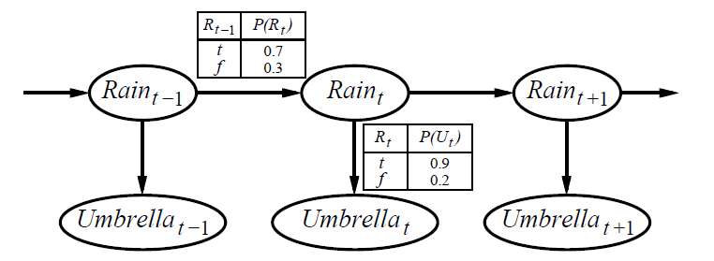
Time and Uncertainty
The complete joint distribution is the combination of the transition model and sensor model
Bayesian network for umbrella world

Slide 9
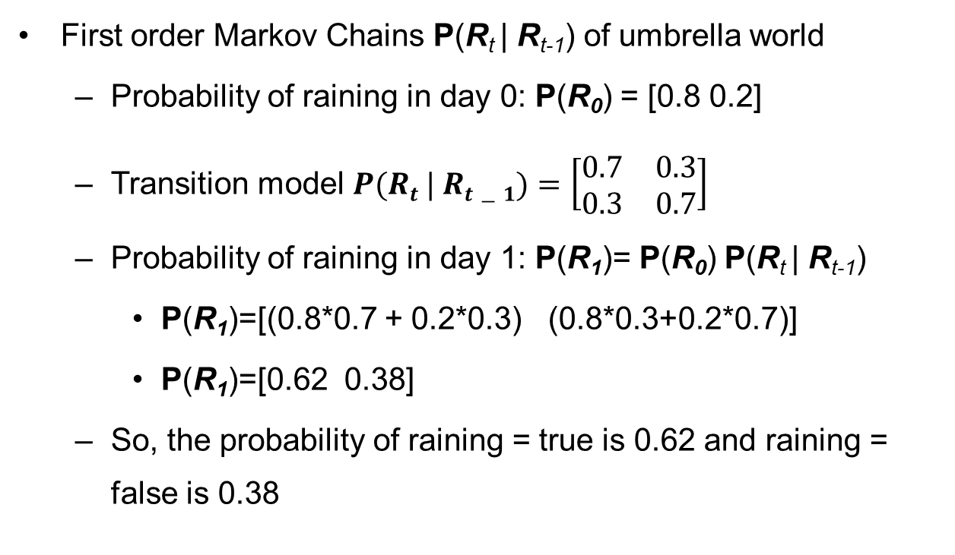
Markov Chains
First order Markov Chains P(R_{t} | R_{t-1}) of umbrella world
Probability of raining in day 0: P(R₀) = [0.8 0.2]
Transition model $P(Rt | Rt−1)=\left[\begin{matrix}0.7 & 0.3 \\ 0.3 & 0.7\end{matrix}\right]$
Probability of raining in day 1: P(R₁)= P(R₀) P(R_{t} | R_{t-1})
P(R₁)=[(0.8*0.7 + 0.2*0.3) (0.8*0.3+0.2*0.7)]
P(R₁)=[0.62 0.38]
So, the probability of raining = true is 0.62 and raining = false is 0.38

Slide 10
Markov Chains
Example
A child with a lower-class parent has a 60% chance of remaining in the lower class, has a 40% chance to rise to the middle class, and has no chance to reach the upper class.
A child with a middle-class parent has a 30% chance of falling to the lower class, a 40% chance of remaining middle class, and a 30% chance of rising to the upper class.
A child with an upper-class parent have no chance of falling to the lower class, has a 70% chance of falling to the middle class, and has a 30% chance of remaining in the upper class.

Slide 11
Markov Chains
Example
Assuming that 20% of the population belongs to the lower class, that 30% belong to the middle class, and that 50% belong to the upper class.

Slide 12

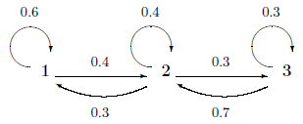
Markov Chains
Example
Markov transition matrix
Markov transition diagram
Initial condition

Slide 13




Markov Chains
Solution
Illustrate, consider population dynamics over the next 4 generations is :

Slide 14
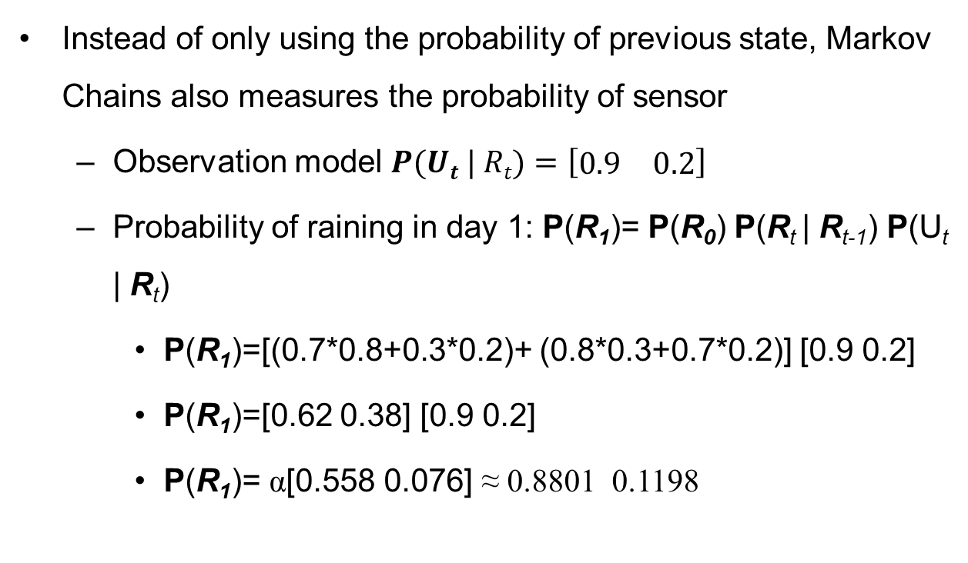
Markov Chains
Instead of only using the probability of previous state, Markov Chains also measures the probability of sensor
Observation model $P(Ut | Rt)=\left[\begin{matrix}0.9 & 0.2\end{matrix}\right]$
Probability of raining in day 1: P(R₁)= P(R₀) P(R_{t} | R_{t-1}) P(U_{t} | R_{t})
P(R₁)=[(0.7*0.8+0.3*0.2)+ (0.8*0.3+0.7*0.2)] [0.9 0.2]
P(R₁)=[0.62 0.38] [0.9 0.2]
P(R₁)= α[0.558 0.076] ≈ 0.8801 0.1198

Slide 15
Inference in Temporal Model
Inference tasks:
Filtering: computing the belief state
Current state estimation P(X_{t} | e_{1:t})
Prediction: computing the posterior distribution of future state
Future state prediction P(X_{t+k} | e_{1:t})
Smoothing: computing the posterior distribution of past state
Past state analysis P(X_{k} | e_{1:t})
Most likely explanation: pattern analysis P(X_{1:t} | e_{1:t})

Slide 16
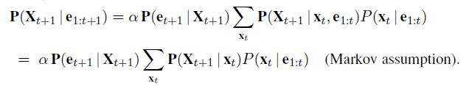
Inference in Temporal Model
Filtering and prediction
To recursively update the distribution using a forward message from previous states
Prediction can be seen simply as filtering without the addition of new evidence
new evidence

Slide 17
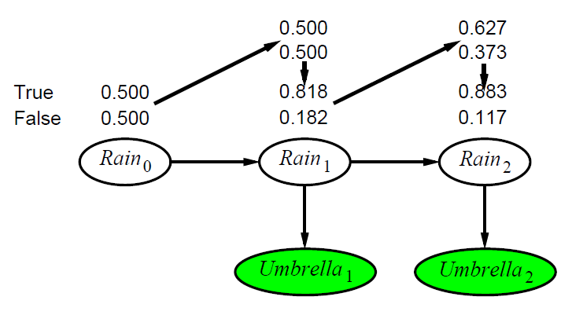
Inference in Temporal Model
P(R₂|u₁) = ∑ P(R₂|r₁) P(r₁|u₁)
= (.7 .3) * .818 + .3 .7) * .182
Filtering
P(R₁) = P(R₀) P(R₁|R₀)
P(R₁|u₁) = α P(u₁|R₁) P(R₁)
P(R₂|u₁,u₂) = α P(u₂|R₂) P(R₂|u₁)

Slide 18
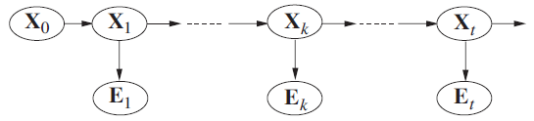
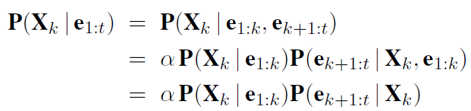
Inference in Temporal Model
Smoothing
Process of computing the distribution over past states given evidence up to the present
The computation can be split into two parts: forward message and backward message
forward
backward

Slide 19
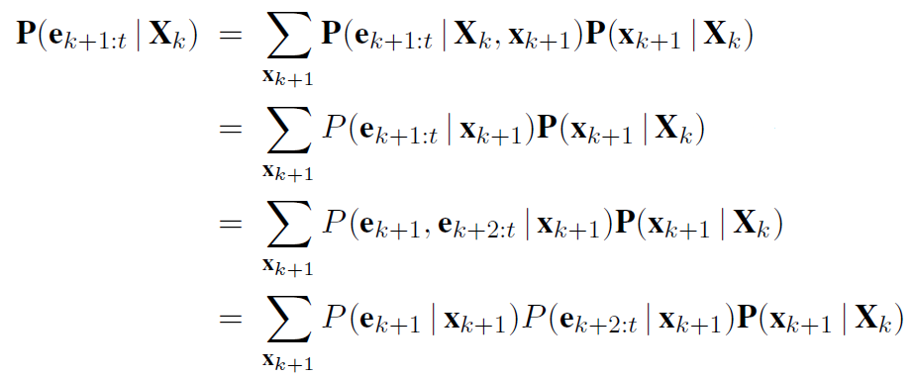
Inference in Temporal Model
Smoothing
The process of backward message

Slide 20
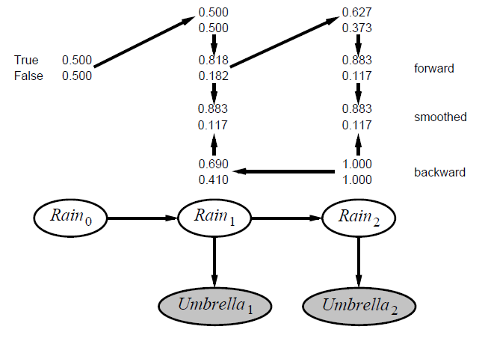
Inference in Temporal Model
Smoothing
P(u₂|R₁) = P(u₂|r₂) P( |r₂) P(r₂|R₁)
.9*1*(.7 .3) + .2*1*(.3.7) = (.69 .41)
P(R₁|u₁,u₂) = α P(R₁|u₁) P(u₂|R₁)
α (.818 * .182)*(.69 * .41) =
.883 .117

Slide 21
Inference in Temporal Model
Most likely explanation
Suppose that [true, true, false, true, true] is the umbrella sequence for the security guard’s first five days on the job
What is the weather sequence most likely to explain this?
Here, we want find the possible sequence with high probability!
How?

Slide 22
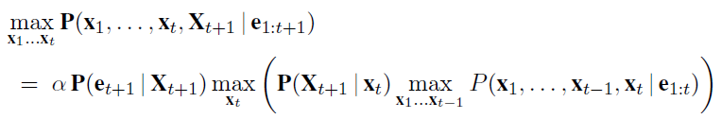
Inference in Temporal Model
Most likely explanation
There is a recursive relationship between the most likely paths to each state x_{t+1} and most likely paths to each state x_{t} (Markov property)
Thus, we can write the relationship as

Slide 23
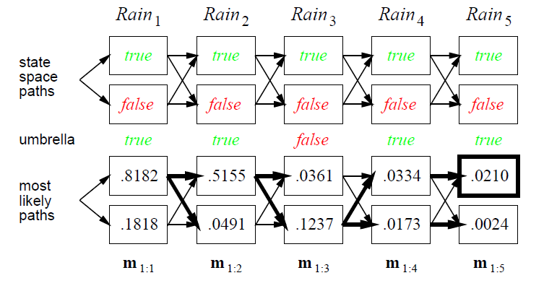
Inference in Temporal Model
Most likely explanation

Slide 24
Hidden Markov Models
Simple Markov models ➔ The observer know the state directly
Hidden Markov models ➔ The observer know the state indirectly (through an output state or observed data)
Umbrella world is an HMM, since the security only knows the rain state from his director’s umbrella existence

Slide 25
Hidden Markov Models
Hidden states
H₁
H₂
H_{i}
H_{L-1}
H_{L}
X₁
X₂
X_{i}
X_{L-1}
X_{L}
Observed data

Slide 28
TOY PROBLEM FOR HMM : Gambar atau diagram HMM (Hidden Markov Model) di bawah ini memperlihatkan pengetahuan Sdr terhadap kebiasaan kebiasaan yang dilakukan oleh salah seorang rekan Sdr. Misalnya, sebagaimana diperlihatkan pada gambar, bila pada hari itu cuacanya hujan (rainy) probabilitas rekan Sdr tsb akan berjalan-jalan (Walk) adalah 0.1, berbelanja (Shopping) 0.4, dan membersihkan rumah (Cleaning) 0.5.
Bila sekarang rekan Sdr tsb mengatakan bahwa untuk tiga (3) hari terakhir dia melakukan aktifitas jalan-jalan (W), berbelanja (S), dan bersih-bersih rumah (C), tentukan the most likely sequence (states) yang menghasilkan observasi tsb (W, S, and C). Gunakan Viterbi algorithm untuk menjawab pertanyaan dalam kasus ini.
W : 0.1
S : 0.4
C : 0.5
W : 0.6
S : 0.3
C : 0.1
0.7
0.3
0.6
RAINY
SUNNY
0.4
0.6
0.4
START

Slide 30
PROBLEM 1 HMM : EVALUATION
RESULT OF FORWARD ALGORITHM SHOWN BY TRELLIS DIAGRAMS
WALK
SHOPPING
CLEANING
RAINY
.7*.4
.7*.5
.6 *.1
.0552
.02904
.3*.3
.3*.1
.4*.4
.4*.5
SUNNY
.4 *.6
.0486
.00457
.6*.3
.6*.1
t =0
t =1
t =2
TOTAL PROBABILITY ≈ 0.03361 (.02904 + .00457)

Slide 32
PROBLEM 2 HMM : MOST LIKELY SEQUENCE
RESULT OF VITERBI ALGORITHM SHOWN BY TRELLIS DIAGRAMS
WALK
SHOPPING
CLEANING
RAINY
.7*.5
.6 *.1
.0384
.01344
.4*.4
SUNNY
.4 *.6
.0432
.00259
.6*.3
.6*.1
t =0
t =1
t =2
OPTIMAL PATH ≈ SUNNY – RAINY – RAINY
TOTAL PROBABILITY ≈ 0.01344

Slide 33
HIDDEN MARKOV MODEL : COIN TOSS PROBLEM
ANOTHER TOY PROBLEM : Diketahui sebuah model HMM λ = { π, A(i,j), B(i,j)} dengan π = (0.6, 0.4) dan A(i,j) serta B(i,j) sebagaimana diperlihatkan oleh diagram HMM di bawah ini. Tentukan the most likely sequence of hidden states bila urutan pengamatan menghasilkan Head, Tail, Tail, Head (H, T, T, H).
0.9
0.7
0.1
fair
biased
transition probabilities
0.3
0.5
0.5
0.8
0.2
emission probabilities
H
T
H
T

Slide 34
PROBLEM 1 HMM : EVALUATION
RESULT OF FORWARD ALGORITHM SHOWN BY TRELLIS DIAGRAMS
H
T
T
H
FAIR
.9*.5
.9*.5
.9*.5
.6 *.5
.183
.08997
.042102
.1*.2
.1*.2
.1*.8
.3*.5
.3*.5
.3*.5
BIASED
.4 *.8
.0508
.01077
.01323
.7*.2
.7*.2
.7*.8
t =0
t =1
t =2
t =3
TOTAL PROBABILITY ≈ 0.055332 (.042102 + .01323)
0.9
0.7
0.1
fair
biased
transition probabilities
0.3
0.5
0.5
0.8
0.2
emission probabilities
H
T
H
T

Slide 35
PROBLEM 2 HMM : MOST LIKELY SEQUENCE (DECODING)
RESULT OF VITERBI ALGORITHM SHOWN BY TRELLIS DIAGRAMS
H
T
T
H
FAIR
.9*.5
.9*.5
.9*.5
.6 *.5
.135
.06075
.02734
.1*.8
BIASED
.4 *.8
.0448
.00627
.00486
.7*.2
.7*.2
t =0
t =1
t =2
t =3
OPTIMAL PATH ≈ FAIR – FAIR – FAIR – FAIR
TOTAL PROBABILITY ≈ 0.02734

Slide 36
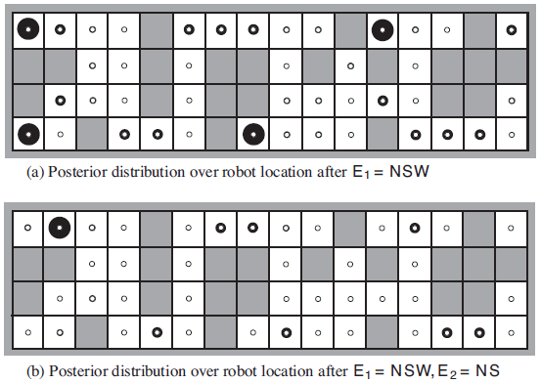
Hidden Markov Models
We don’t know the location, but we know the output of the sensors

Slide 37
Dynamic Bayesian Network
A dynamic Bayesian network or DBN is a Bayesian network that represents a temporal probability model
Example: The umbrella world
Every HMM is a DBN with a single state variable and a single evidence variable, vice versa
The relation between HMM and DBN is analogous to the relation between Bayesian networks and full tabulated joint distributions

Slide 38
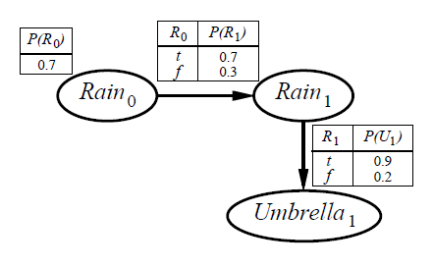
Dynamic Bayesian Network
To construct a DBN, we must specify three kinds of information:
The prior distribution over the state variables P(X₀)
The transition model P(X_{t+1} | X_{t})
The sensor model P(E_{t} | X_{t})

Slide 39
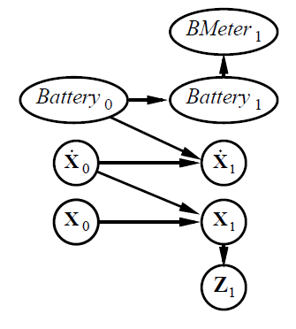
Dynamic Bayesian Network
Example
Monitoring a battery-powered robot moving in the X-Y plane
State:
State for position and velocity
Measurement state
Battery level state
Battery charge level state
Describe the relation between states!

Slide 40
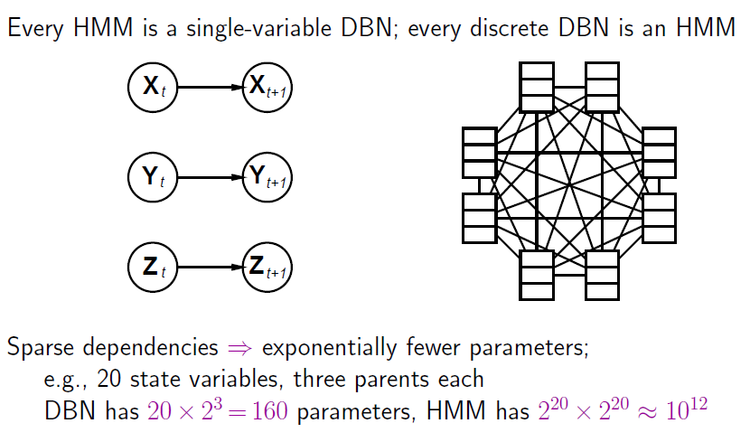
DBN vs HMM

Slide 41
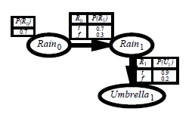
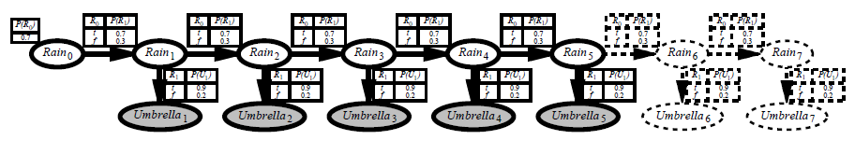
Dynamic Bayesian Network
Inference in DBNs: Unrolling a dynamic Bayesian network

Slide 42
Exercise

Slide 43
Markov Chains
Example
A child with a lower-class parent has a 60% chance of remaining in the lower class, has a 40% chance to rise to the middle class, and has no chance to reach the upper class.
A child with a middle-class parent has a 30% chance of falling to the lower class, a 40% chance of remaining middle class, and a 30% chance of rising to the upper class.
A child with an upper-class parent have no chance of falling to the lower class, has a 70% chance of falling to the middle class, and has a 30% chance of remaining in the upper class.

Slide 44
Markov Chains
Example
Assuming that 20% of the population belongs to the lower class, that 30% belong to the middle class, and that 50% belong to the upper class.

Slide 45
Markov Chains
Example
Markov transition matrix
Markov transition diagram
Initial condition

Slide 46
Markov Chains
Solution
Illustrate, consider population dynamics over the next 4 generations is :

Slide 47
Exercise
Markov Chain
Suppose a car rental agency has three locations in Jakarta: North Jakarta (labelled as N), West Jakarta (labelled as W), and South Jakarta (labelled as S). The agency has a group of delivery drivers to serve all three locations. The agency statistician’ has determined the following data:
Of the calls to N, 30% are delivered in N, 30% are delivered in W, and 40% are delivered in S
Of the calls to W, 40% are delivered in N, 40% are delivered in W, and 20% are delivered in S.
Of the calls to S, 50% are delivered in N, 30% are delivered in W, and 20% are delivered in S.
If on Monday, the drivers that begins in N, 30% will again be in N, 30% will be in W, and 40% will be in S, what is the percentage in every location on Wednesday?

Slide 48
References
Stuart Russell, Peter Norvig. 2010. Artificial Intelligence : A Modern Approach. Pearson Education. New Jersey. ISBN:9780132071482

